Slide 1
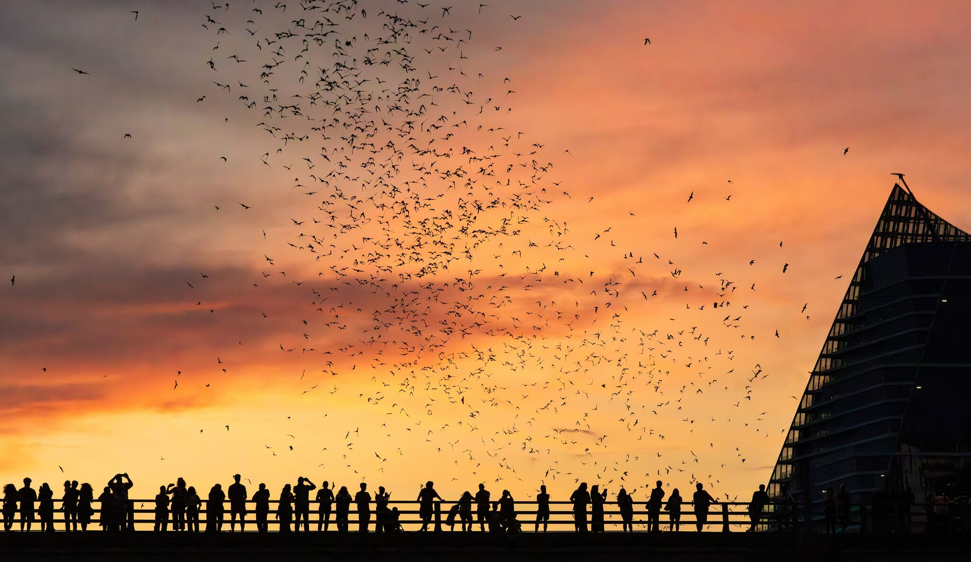
Building with Bats and Birds
Proactive Biodiversity Integration in European Heritage Restoration
Teodora Manole | 21 April 2026
Natuurinclusief Erfgoed: rijkdom barst uit zijn voegen

Slide 2
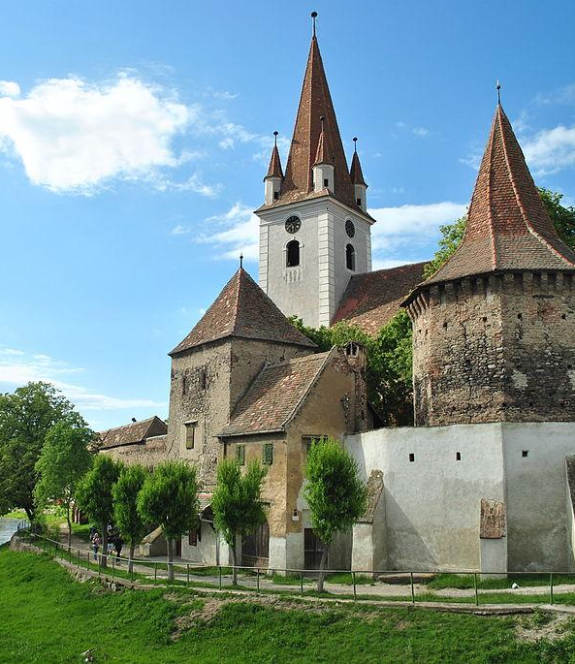
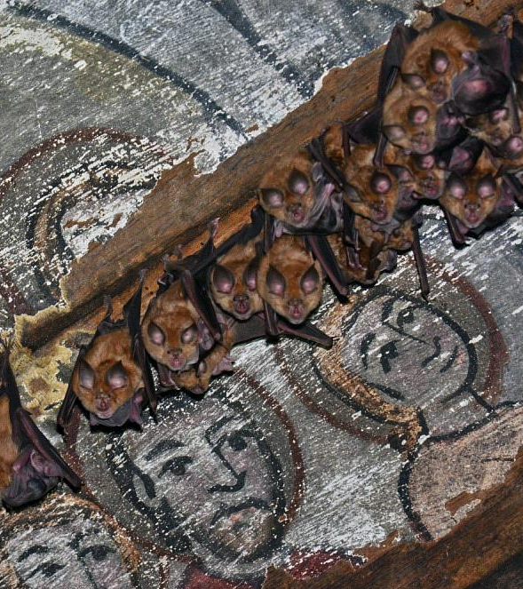
THE DILEMMA
PRICELESS HERITAGE
PROTECTED SPECIES
OBSTACLE...OR OPPORTUNITY

Slide 3
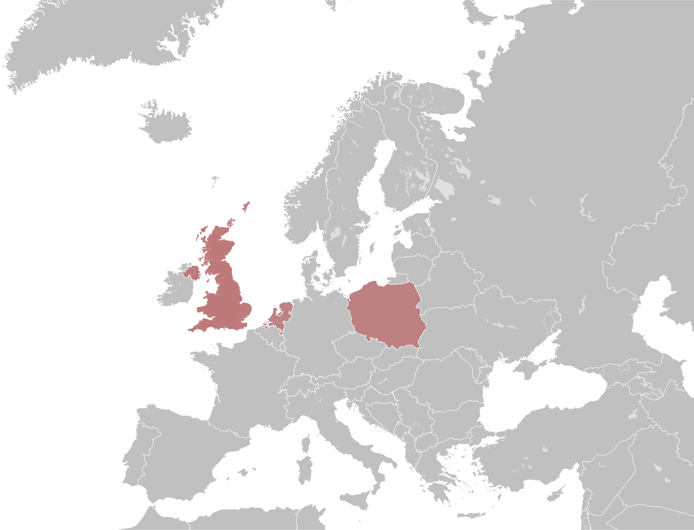
From Conflict to Collaboration:
Four European Stories
The United Kingdom
Part 1:The Bats in Churches Project
The United Kingdom
Part 2:Winchester Cathedral Swift Project
County Mayo (Ireland)
Poland
PODKOWIEC+ Churches
The Netherlands
Waardenburg Castle
Part 1: When obstacles became assets
Part 2: When biodiversity was the plan

Slide 4
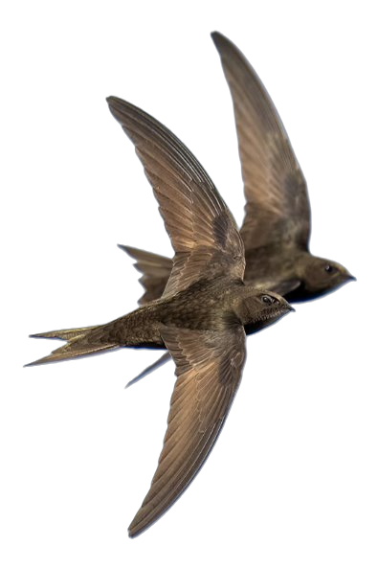
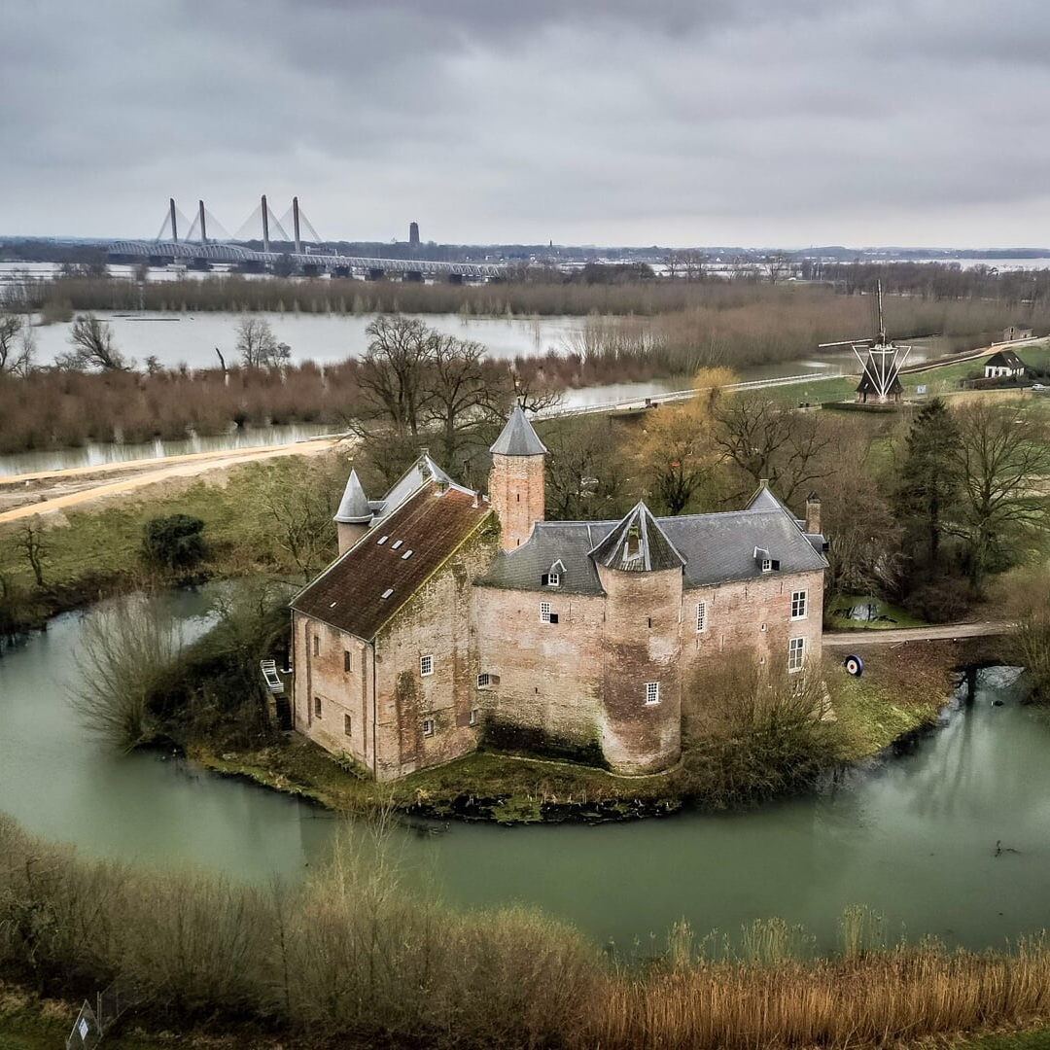
WAARDENBURG Castle the netherlands
Part 1: When obstacles became assets
THE CHALLENGE:
800-year-old castle
€4 million restoration (2007-2009)
80 swifts nesting under old roof tiles
New roof would mean no nesting space

Slide 5
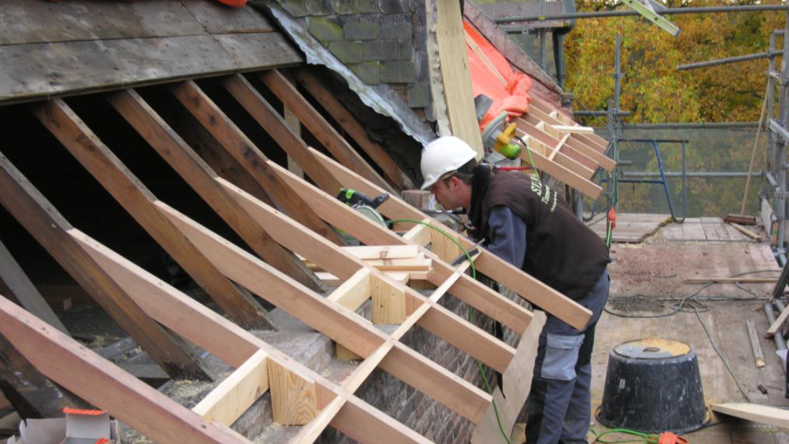
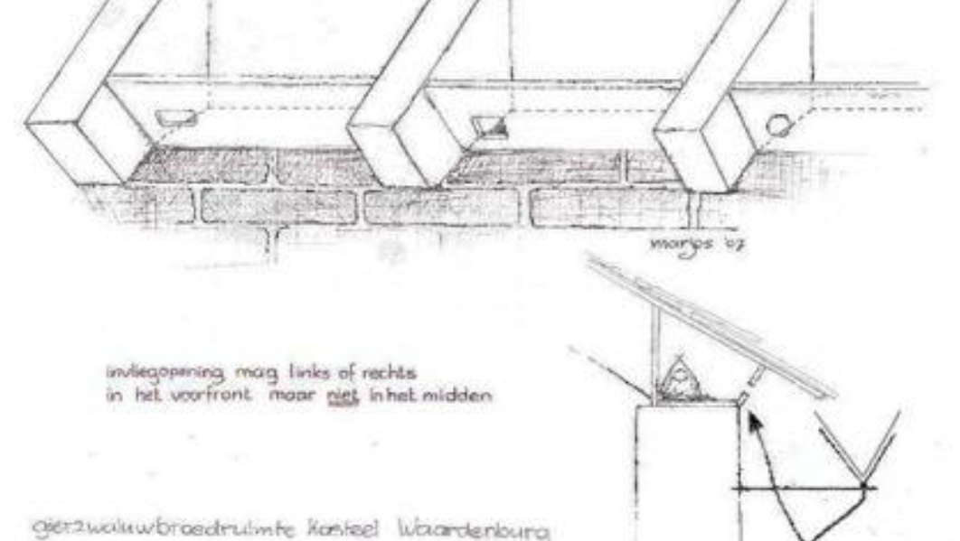
Part 1: When obstacles became assets
WAARDENBURG Castle
the netherlands
THE response:
€71,000 raised specifically for swifts by Geldersch Landschap & Kasteelen (the heritage organization that owns the castle)
Roof work delayed until after breeding season
121 custom nest boxes built into attic spaces
Designed by swift specialists (Zwaluwen Adviesbureau)
PARTNERSHIP:
Owner & fundraiser: Geldersch Landschap & Kasteelen
Technical design: Zwaluwen Adviesbureau
Monitoring: IVN Oisterwijk

Slide 6
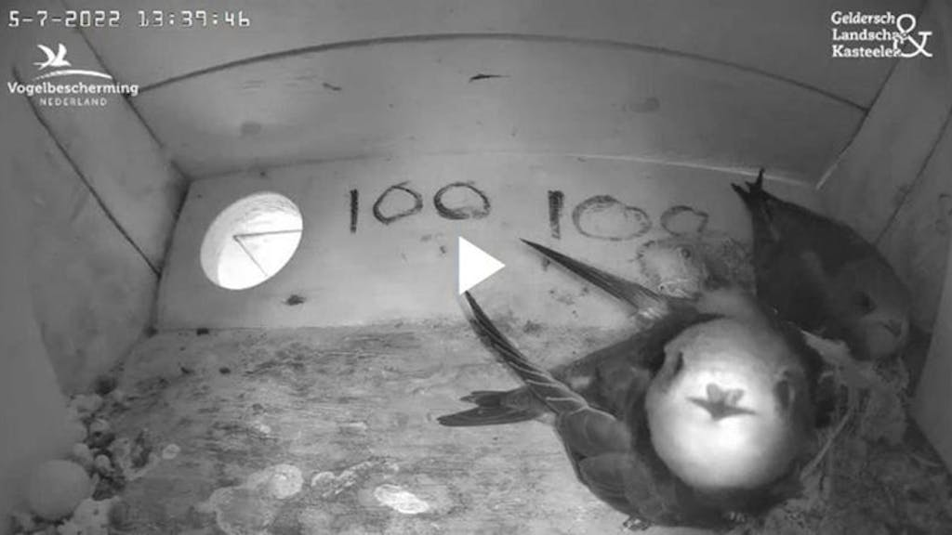
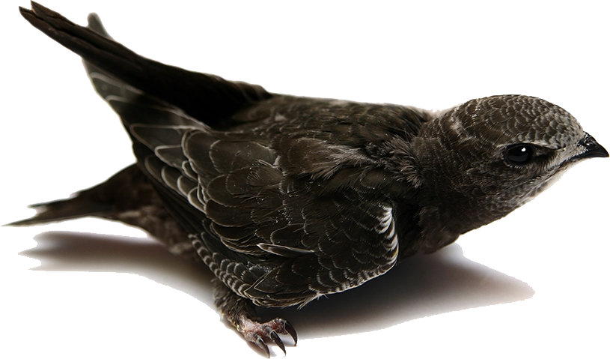
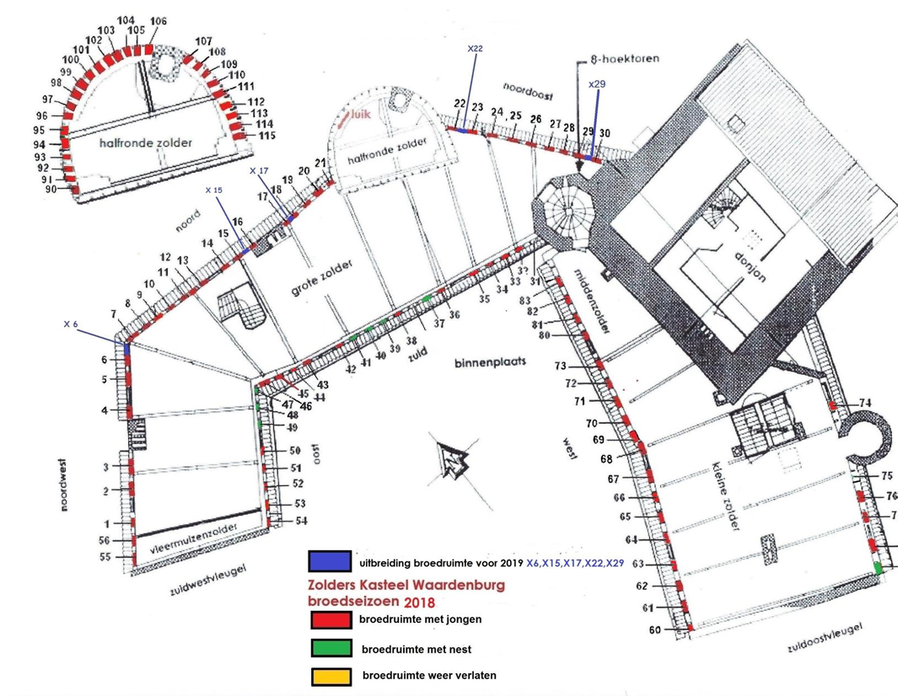
Part 1: When obstacles became assets
WAARDENBURG Castle
the netherlands
THE result:
96 boxes occupied (2018)
~160 young swifts raised annually
Annual monitoring program (10+ years)
Educational livestream for the public
The colony is thriving
The castle hosts birdwatching events, attracting even more visitor

Slide 7
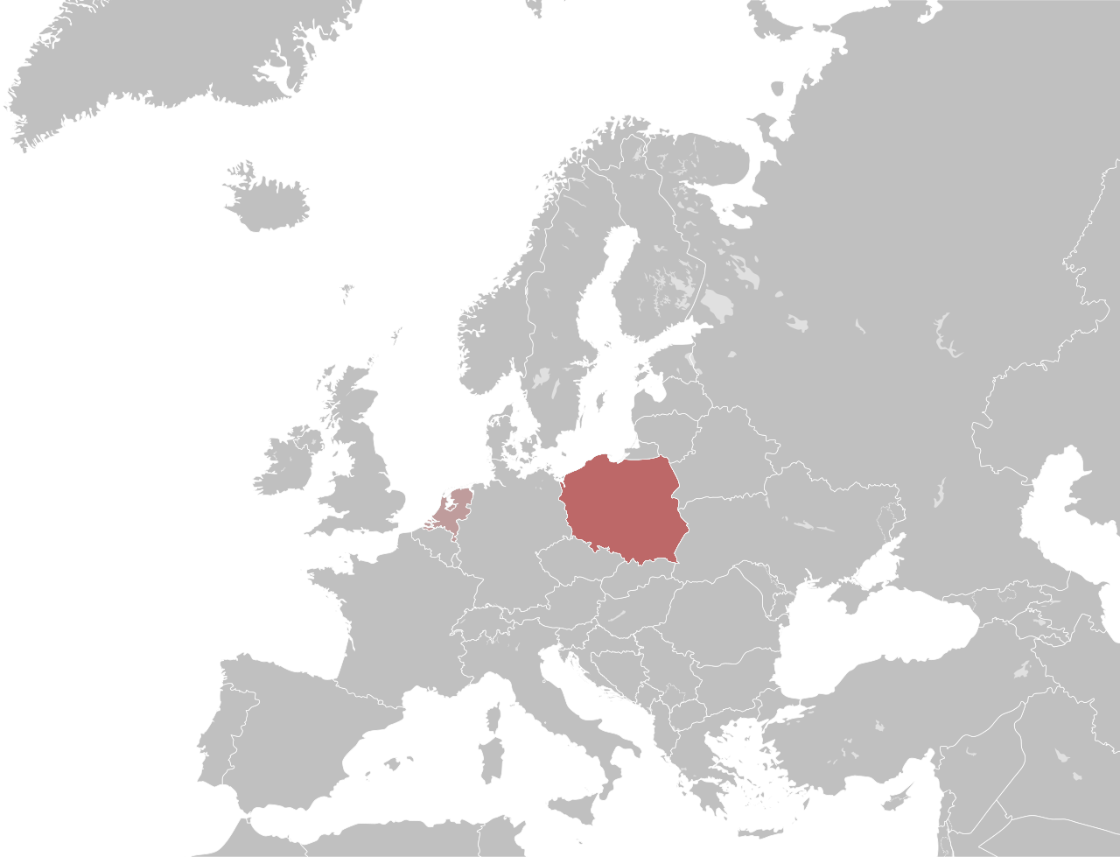
From THE NETHERLANDS TO POLAND
Part 1: When obstacles became assets
Poland
PODKOWIEC+ Churches

Slide 8
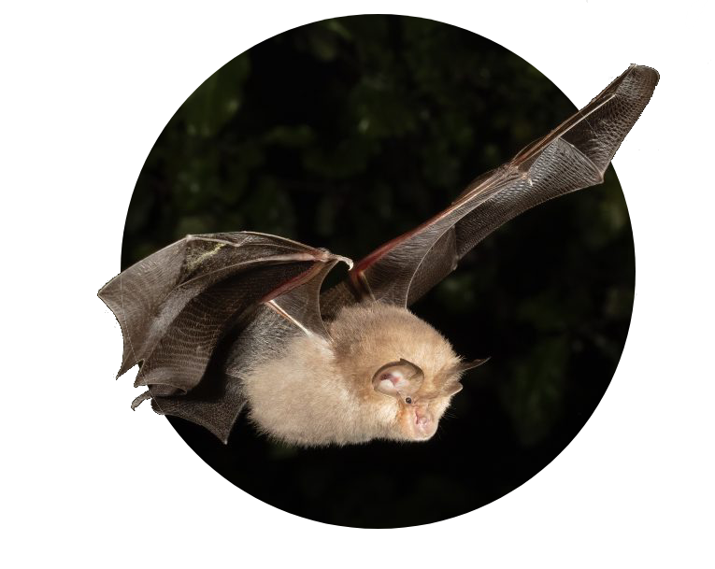
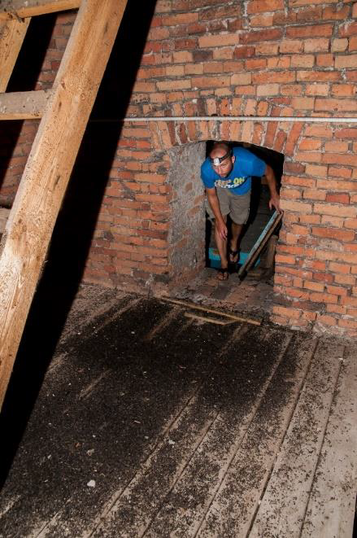
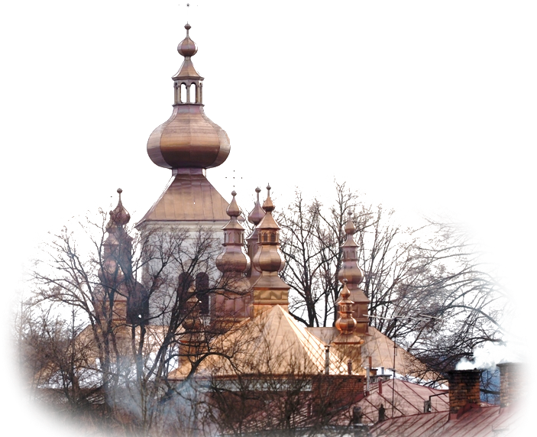
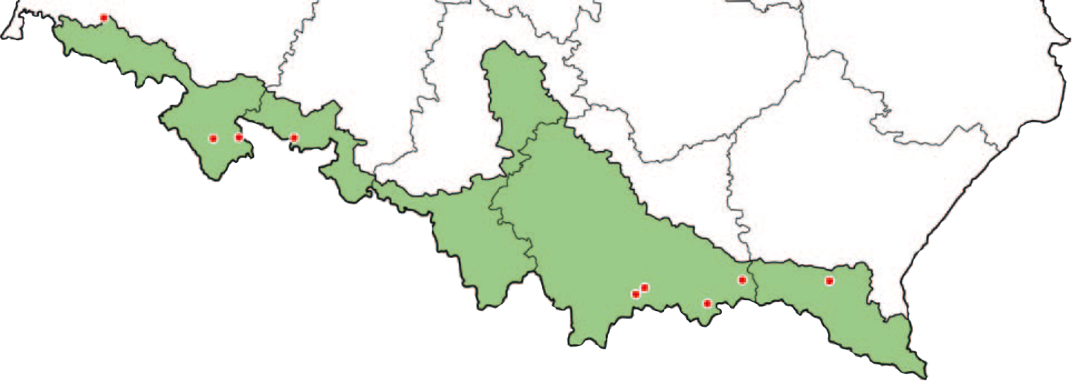
Part 1: When obstacles became assets
PODKOWIEC+ ChurcheS
POLAND
THE CHALLENGE:
9 historic buildings including churches and a historic lime kiln
Roofs failing after decades of neglect
Massive bat colonies (lesser horseshoe, greater mouse-eared)
Urgent question: How to save both heritage AND protected species?

Slide 9
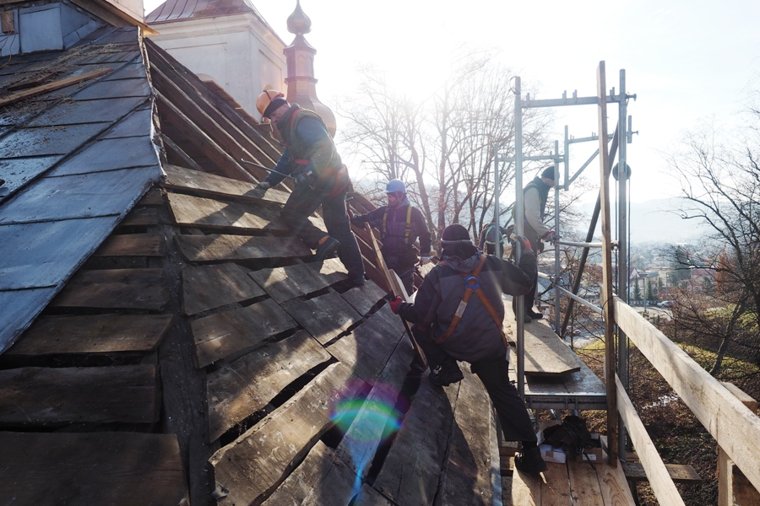
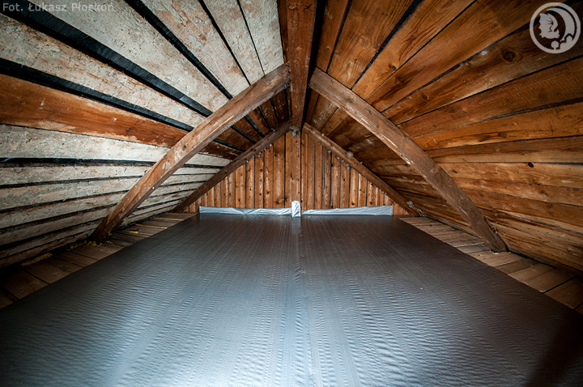
Part 1: When obstacles became assets
PODKOWIEC+ ChurcheS
POLAND
THE response:
Total budget: €3.4 million
EU LIFE+: €1.7M (50%)
Polish National Fund + private co-financing: €1.7M
9 buildings with complete roof restoration
Guano collection platforms installed under roosts
Work scheduled during winter to minimize disturbance to colonies
PARTNERSHIP:
Lead organization: Polskie Towarzystwo Przyjaciół Przyrody "pro Natura"
EU funding: LIFE+ Programme (€1.7M)
Polish national funding: National Fund for Environmental Protection and Water Management
Private co-financing: PPMD (Road Materials Production Enterprise Rzeszów)
Technical partner: Vincent Wildlife Trust

Slide 10
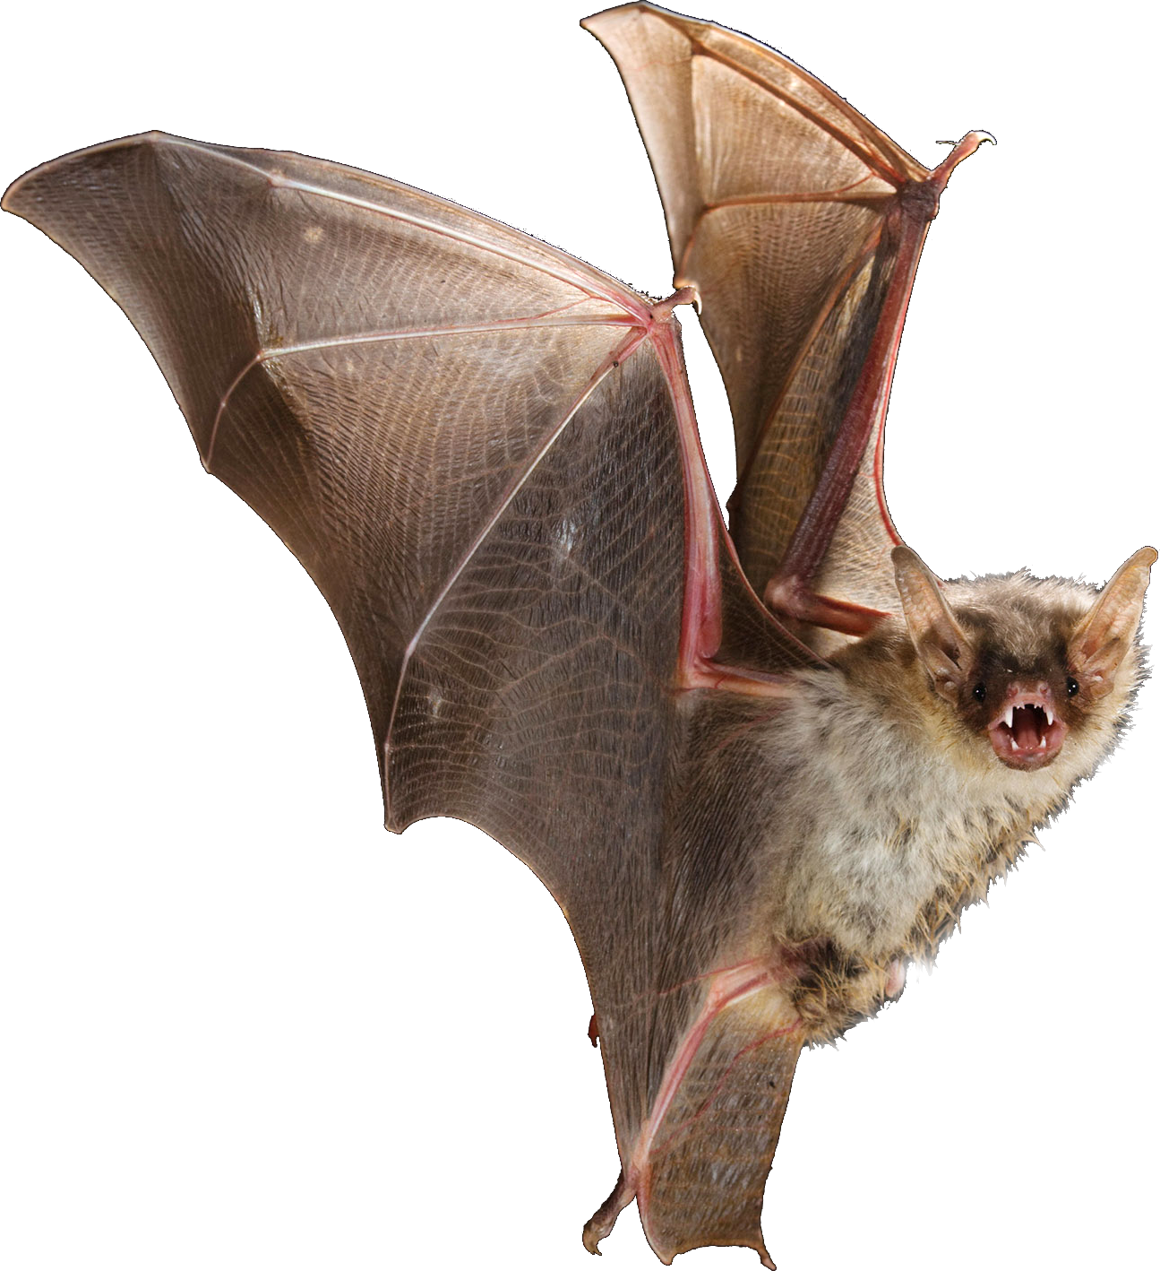
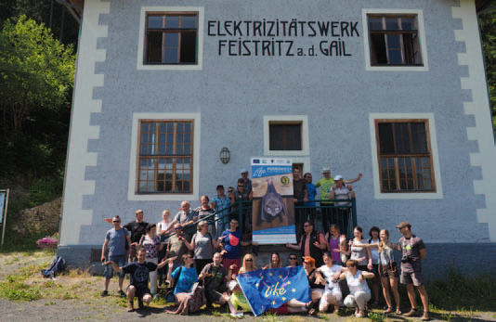
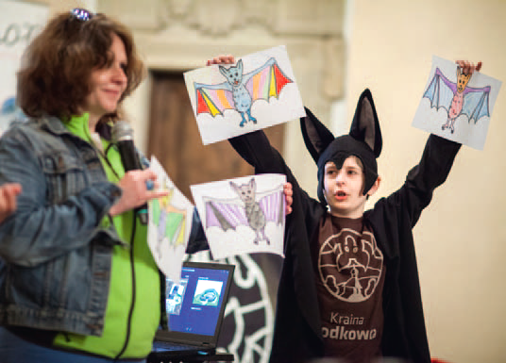
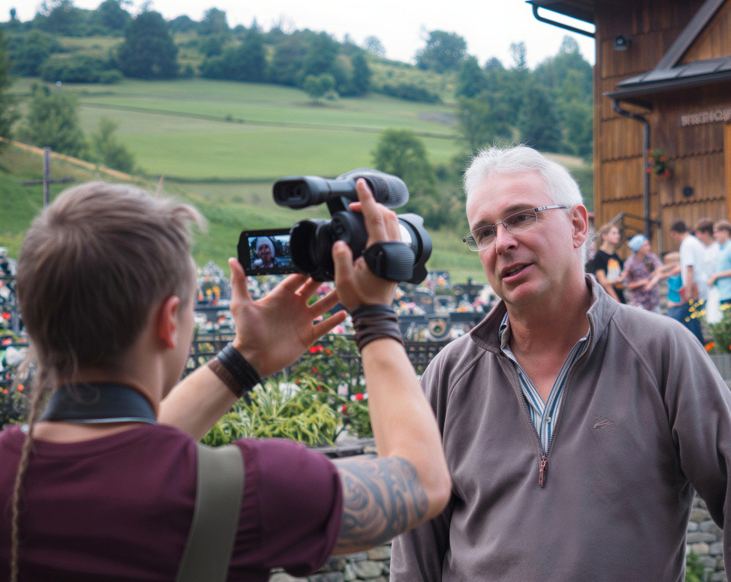
Part 1: When obstacles became assets
PODKOWIEC+ ChurcheS
POLAND
THE result:
All sites fully improved and buildings renovated
+26% lesser horseshoe bats
Building owners now perceive bats as benefit, not burden
"Kraina Podkowca" (Bat's Land) tourism brand created for the area
Educational programs, tourist routes, trained guides
2 TV documentary episodes produced and regular national media coverage

Slide 11
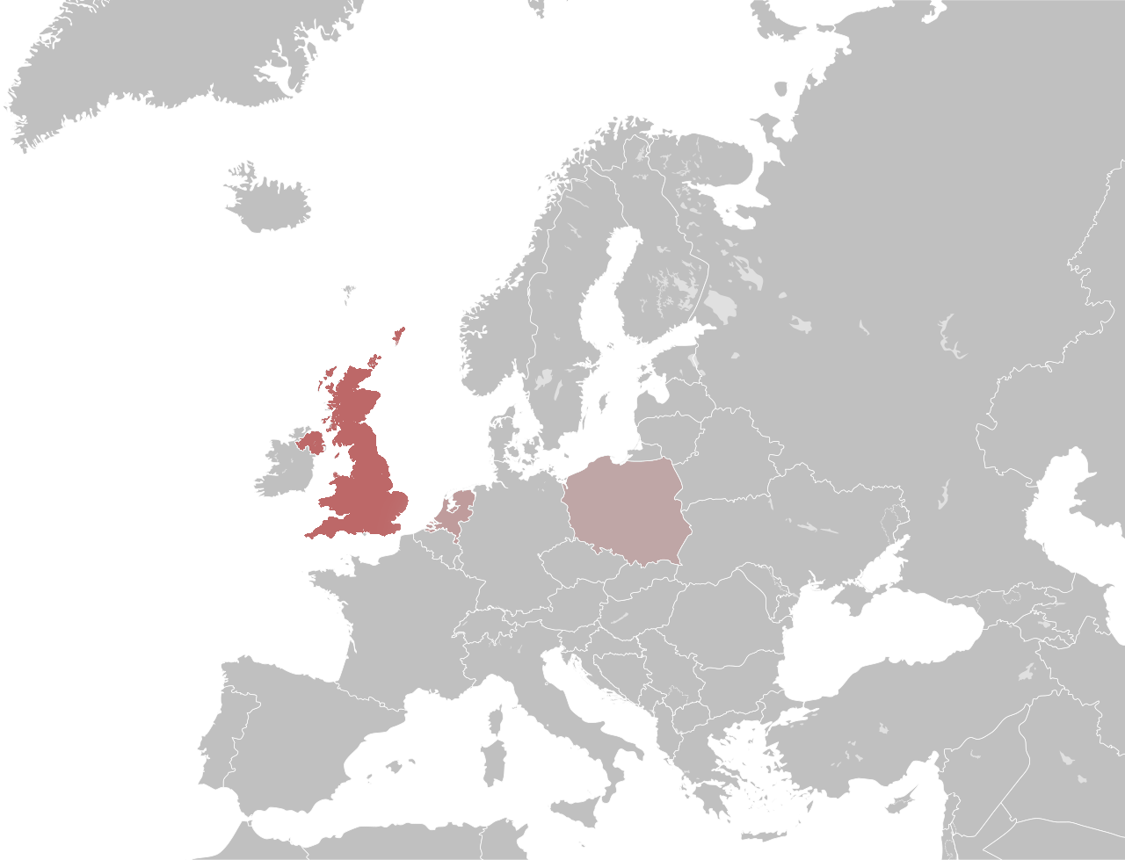
From POLAND TO THE UNITED KINGDOM
Part 1: When obstacles became assets
The United Kingdom
Part 1:The Bats in Churches Project

Slide 12
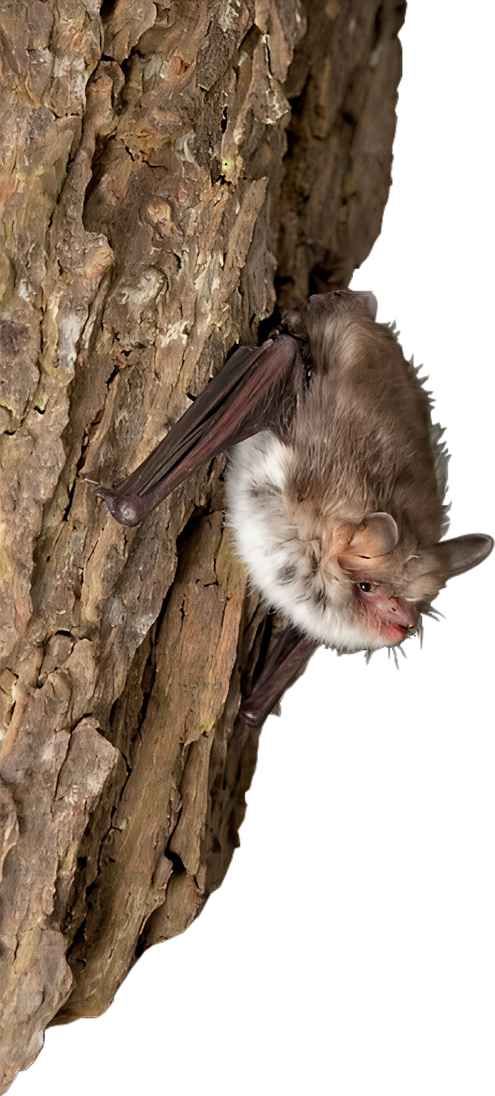
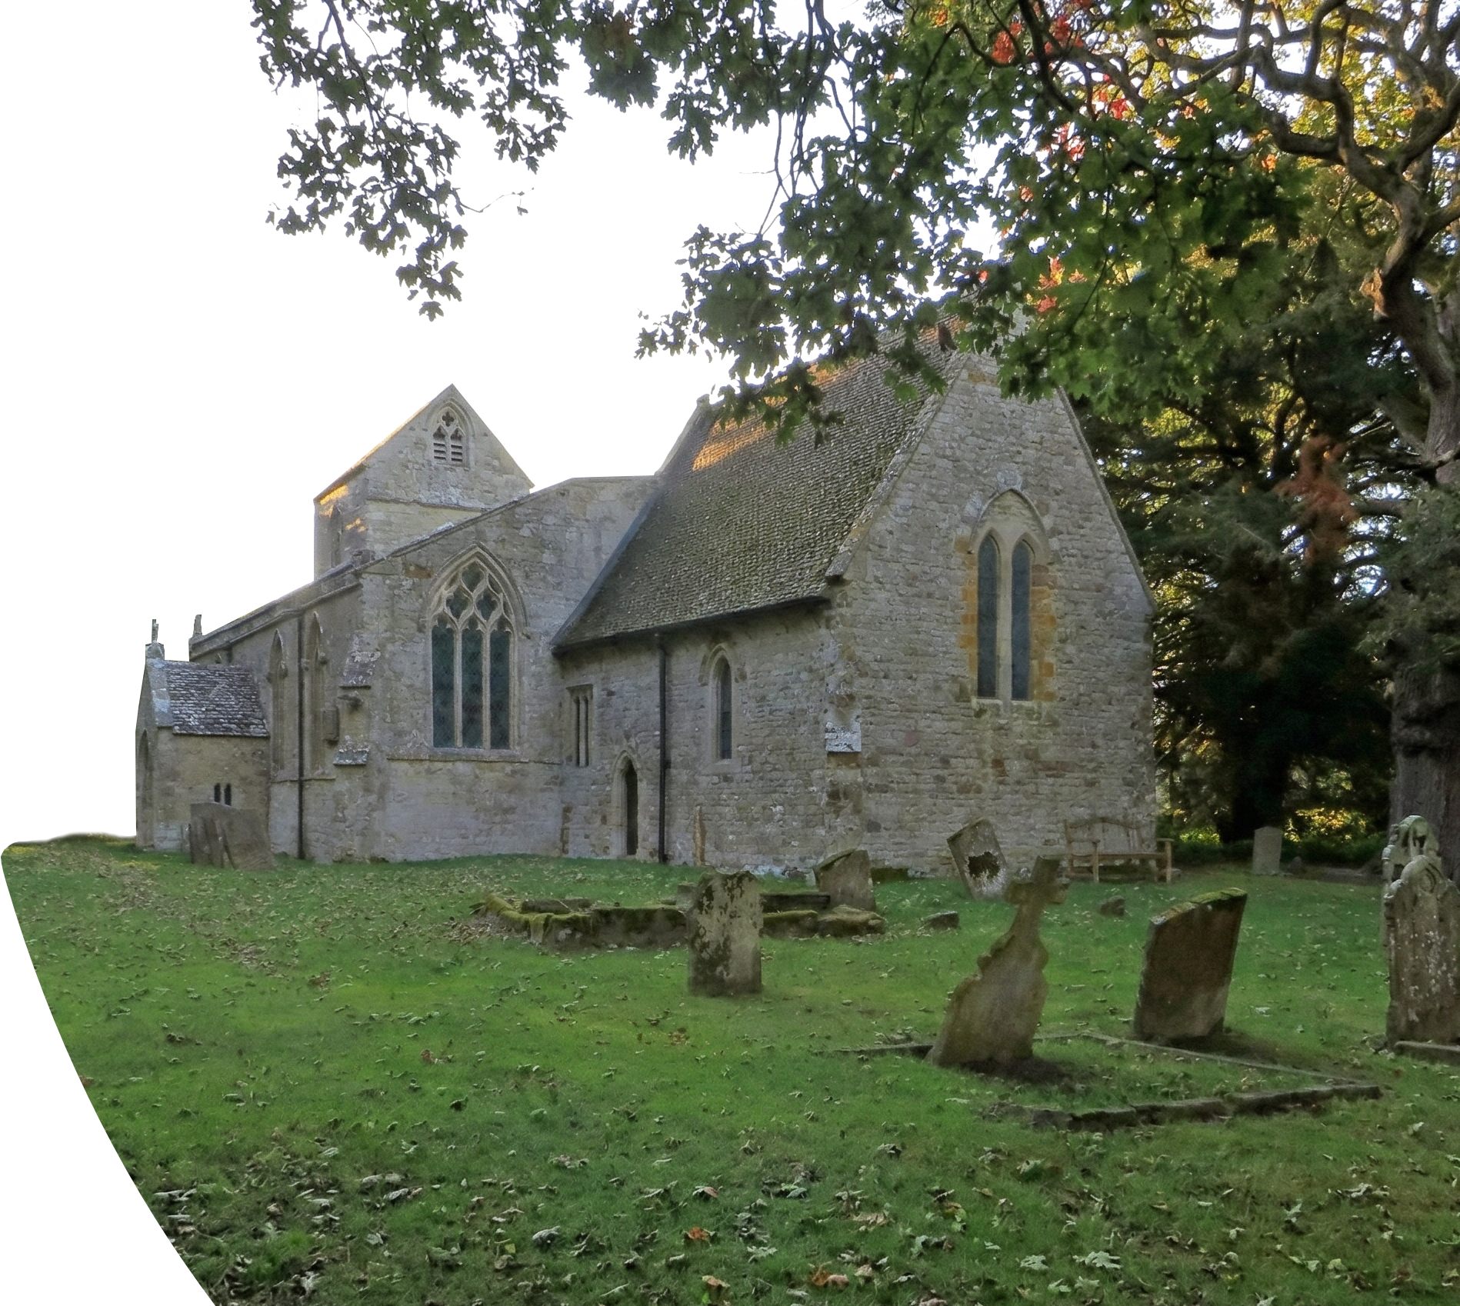
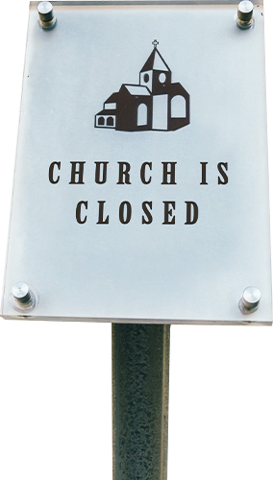
THE BATS IN CHURCHES PROJECT the UNITED KINGDOM
Part 1: When obstacles became assets
ST. Lawrence Radstone CHURCH
"We feared we'd lost our church forever"
August 2016: The Low Point
Medieval grade I listed church (highest level of heritage protection in the UK)
200 Natterer's bats living inside
Bat guano became overwhelming
Church CLOSED indefinitely
Community devastated

Slide 13
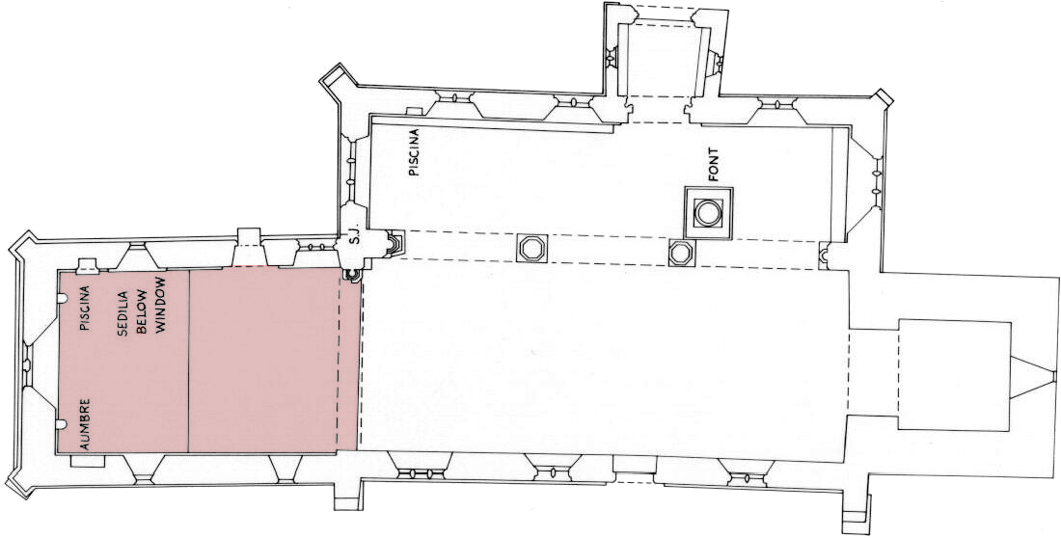
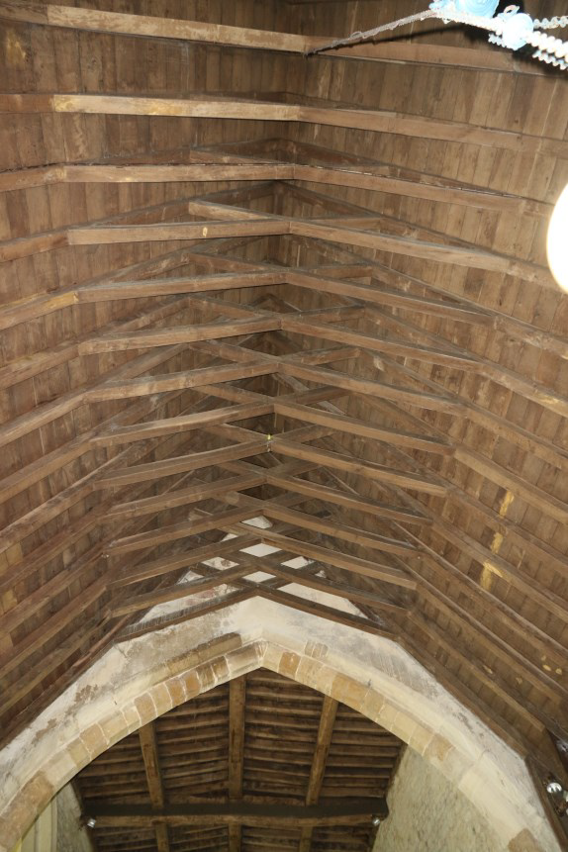
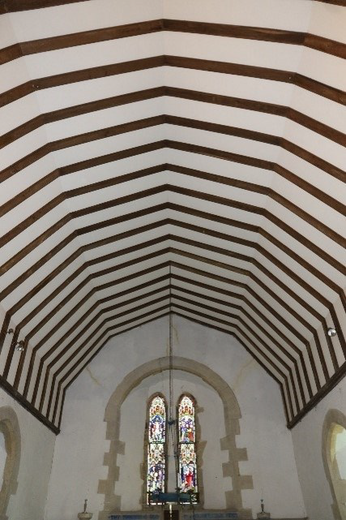
THE BATS IN CHURCHES PROJECT the UNITED KINGDOM
Part 1: When obstacles became assets
THE SOLUTION:
Works started in October 2020 with an investment of £60,057
False ceiling installed in chancel
Bats roost in void above ceiling
Guano falls onto ceiling, cleaned 1-2x/year
Congregation worships in clean space below
Bell tower alterations to enhance roosting options
200 Natterer's bats (maternity colony) + common pipistrelles protected
PARTNERSHIP:
Lead delivery partner: Bat Conservation Trust
Main funding: Heritage Fund (National Lottery)
Building owners: Church of England
Heritage partners: Historic England | Churches Conservation Trust | Architect Adrian Ringrose
Conservation partner: Natural England, Bernwood Ecology

Slide 14
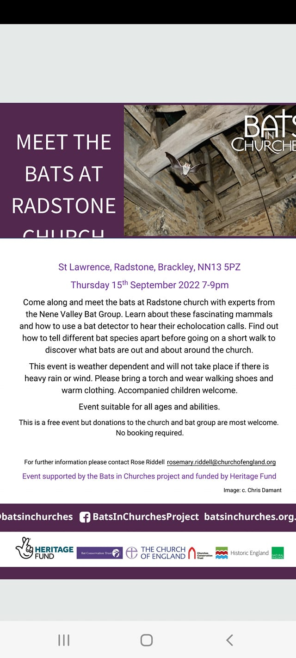
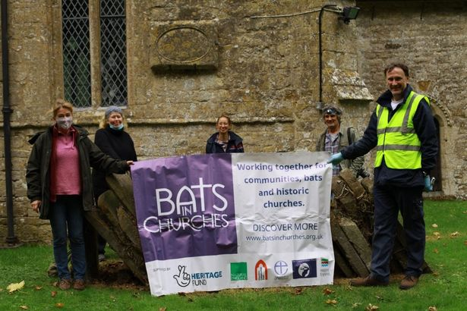
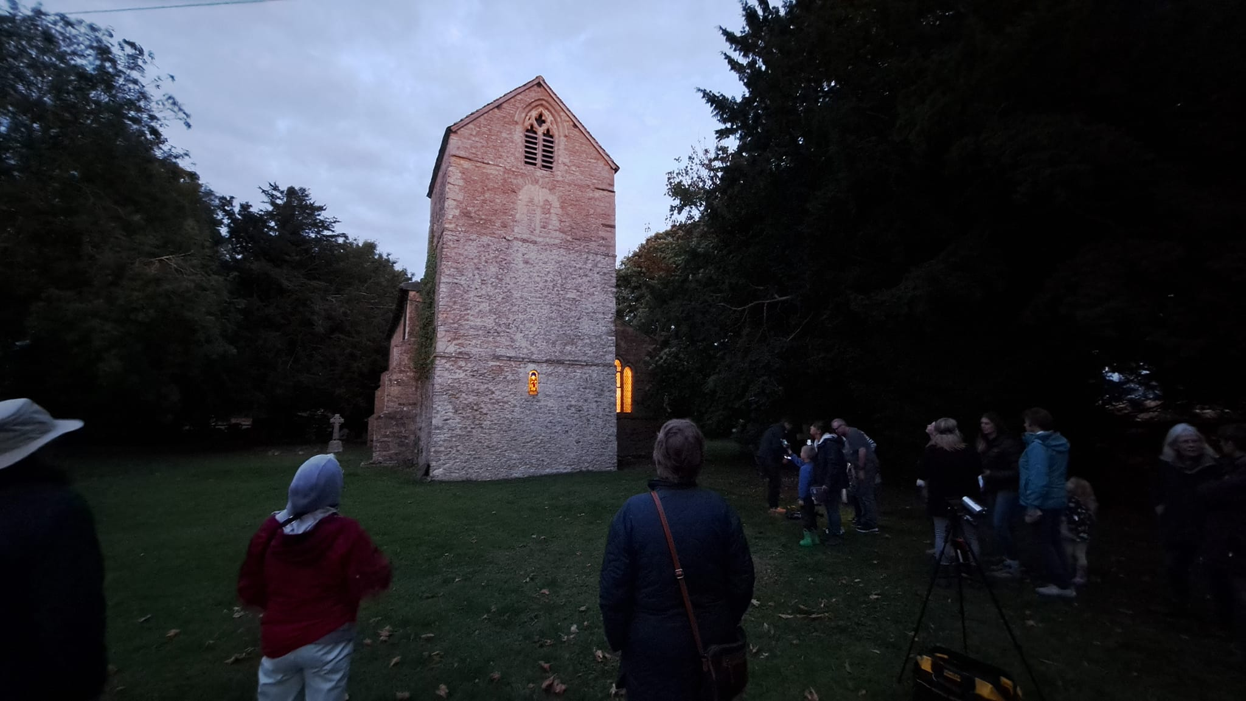
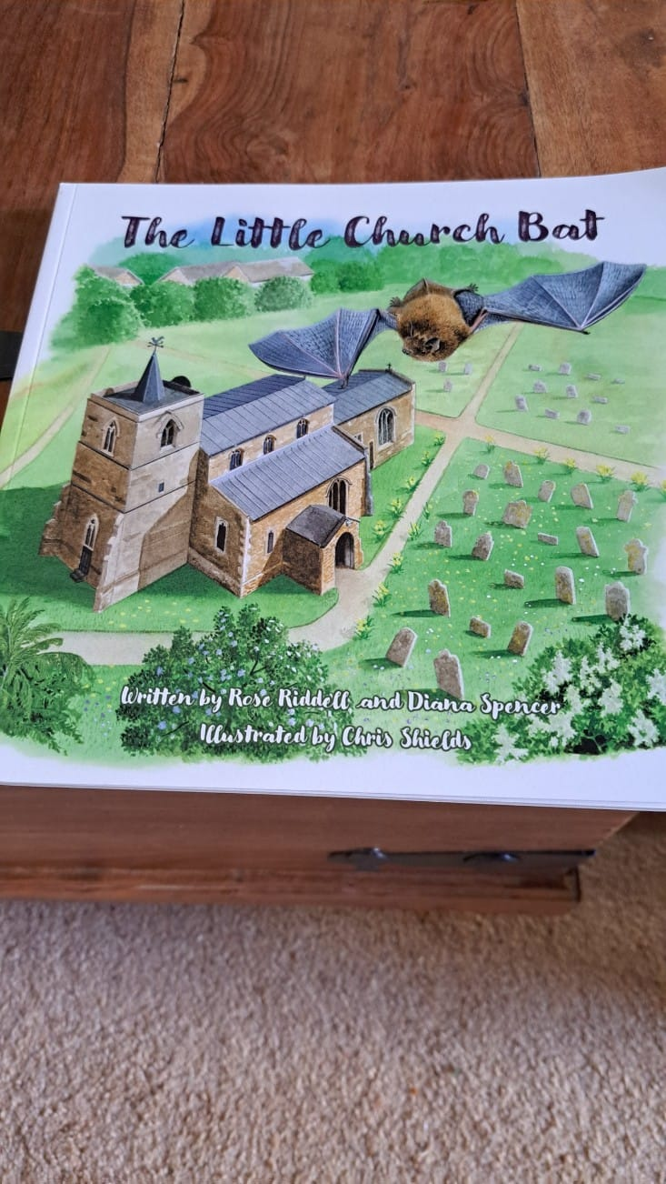
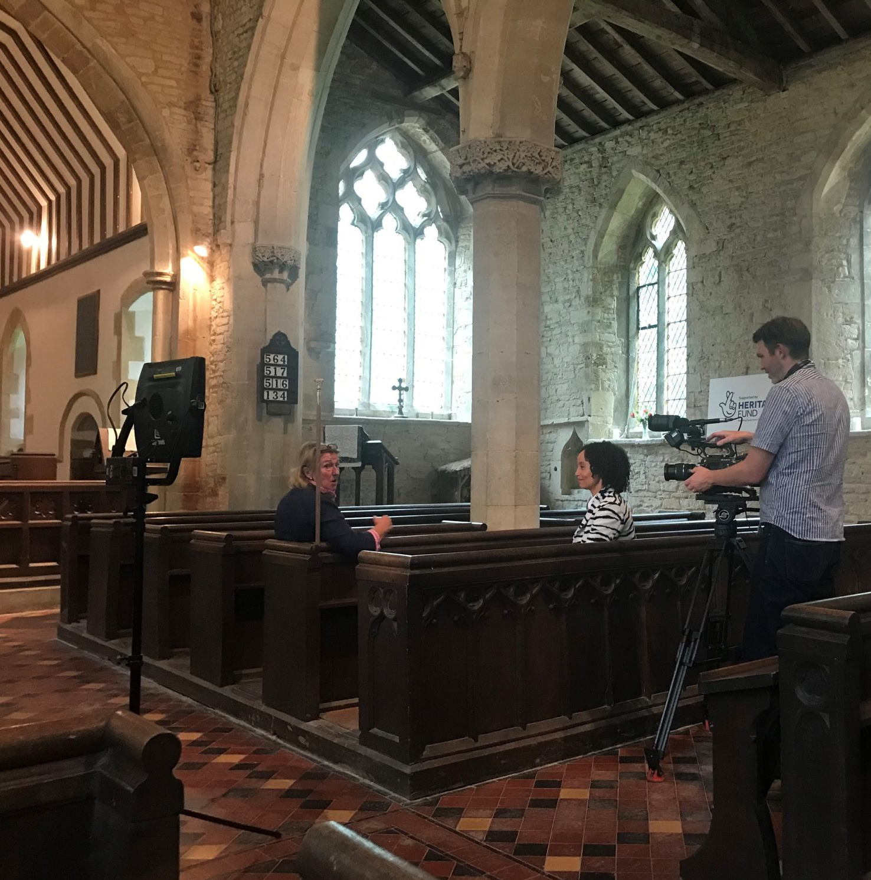
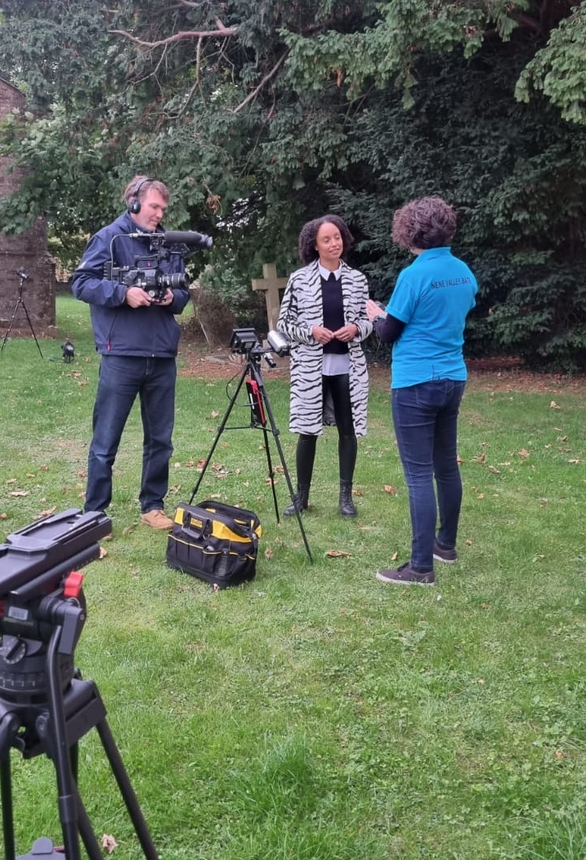
THE BATS IN CHURCHES PROJECT the UNITED KINGDOM
Part 1: When obstacles became assets
THE RESULT:
December 2021: Church reopens after 5+ years of silence
40 parishioners attend first Christmas service
Natterer's bat colony is thriving in chancel void and bell tower
Monthly bat walks with Nene Valley Bat Group
The St. Lawrence Radstone Church was featured on BBC Songs of Praise broadcast
School educational programs established

Slide 15
THE UNITED KINGDOM
Part 2: When biodiversity was the plan
The United Kingdom
Part 2:Winchester Cathedral Swift Project
County Mayo (Ireland)

Slide 16
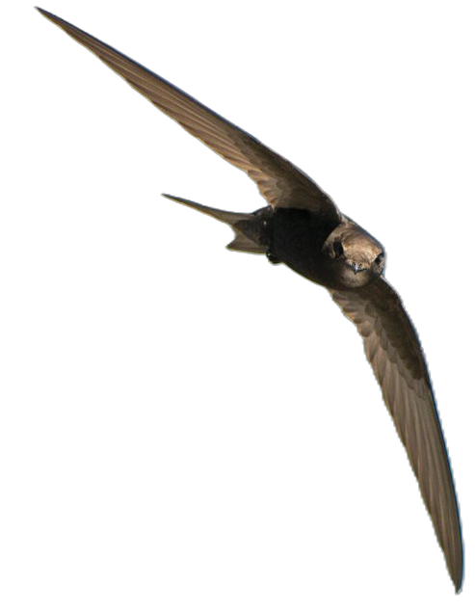
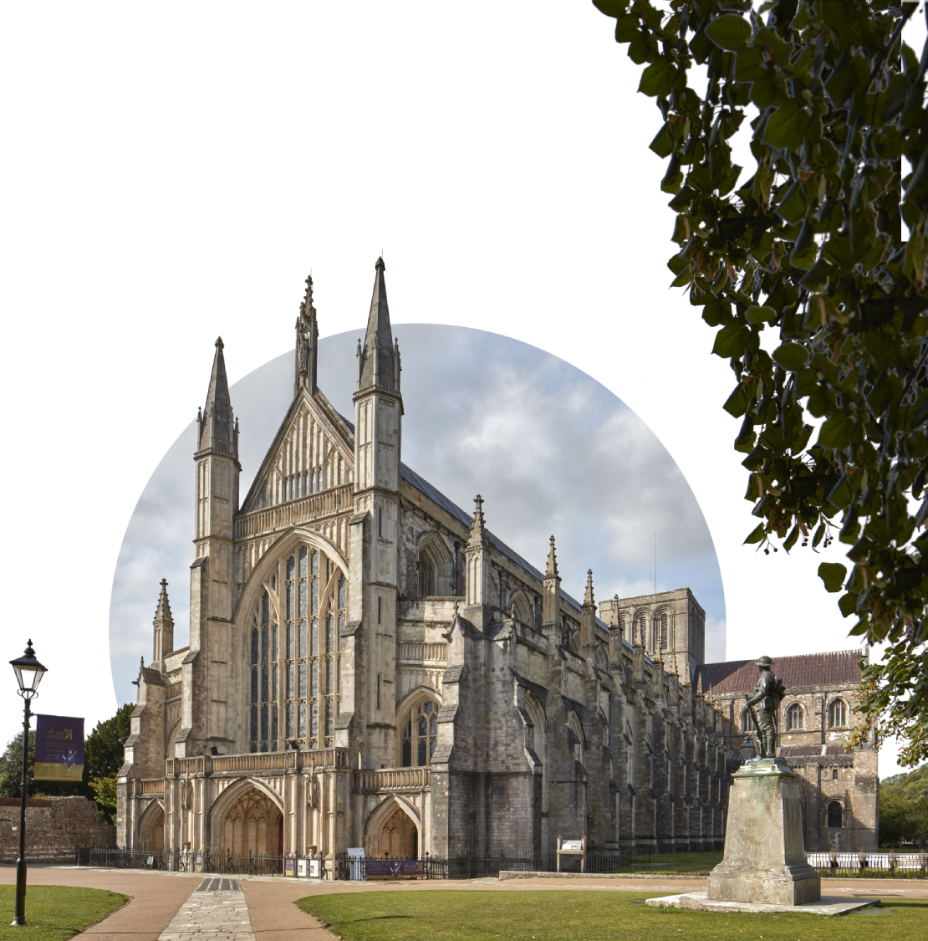
Part 2: When biodiversity was the plan
Winchester Cathedral Swift Project
HAMPSHIRE, the UNITED KINGDOM
THE SITUATION:
UK swift decline: 60% over 25 years, continuing at 5% annually (endangered species - IUCN red list)
Main cause: loss of nest sites through renovation and modern building
Hampshire swifts charity : proactive nest site creation to reverse decline
Winchester Cathedral, 11th-13th century Grade I listed (highest heritage protection level)
Bell tower suitable for swifts but none present
No renovation crisis, no emergency
Can heritage building become swift habitat without crisis? Will swifts colonize an empty site? How long to establish breeding colony?

Slide 17
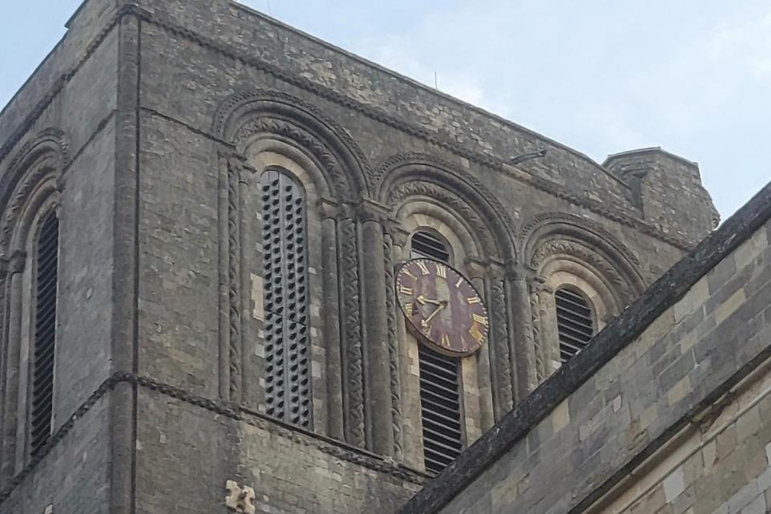
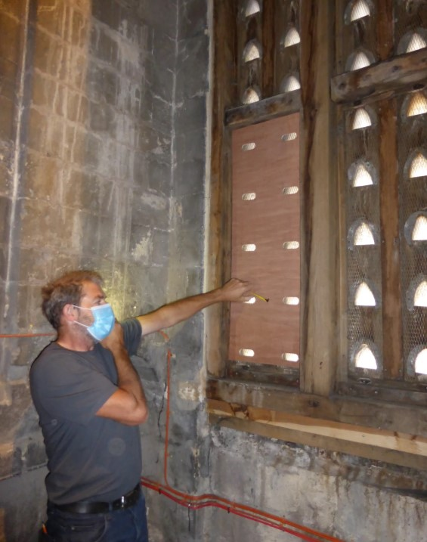
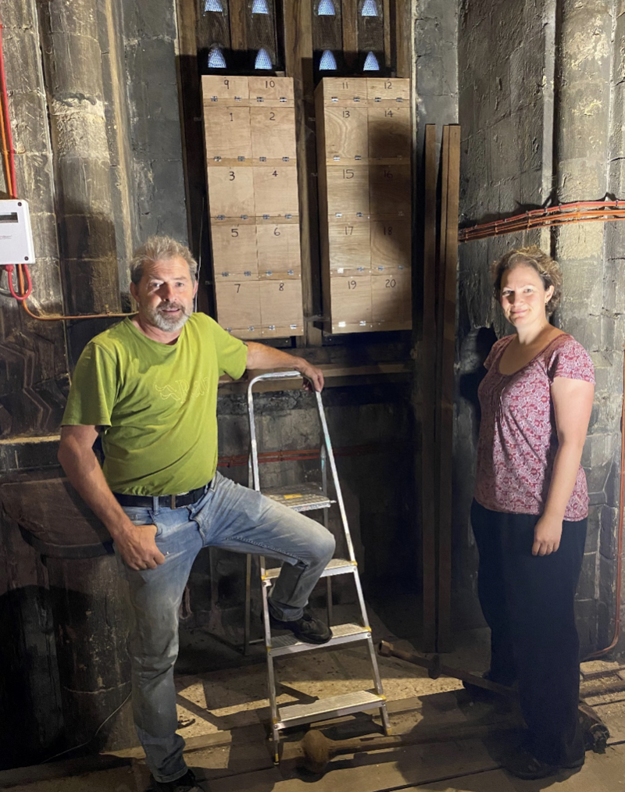
Part 2: When biodiversity was the plan
Winchester Cathedral Swift Project
HAMPSHIRE, the UNITED KINGDOM
THE METHOD:
£300 grant from Birds on the Brink
August 2020: 20 nest boxes installed in bell tower
Boxes fitted behind louvres, south side of tower
May 2021: Acoustic call system activated
Plays swift duets 3× daily (morning, noon, evening)
Attracts prospecting birds searching for nest sites
Annual November inspections to monitor occupancy
PARTNERSHIP:
Lead organization: Hampshire Swifts
Funding: Birds on the Brink
Heritage partner: Winchester Cathedral
Technical delivery: Hampshire Swifts team
Cathedral liaison: Verger Ian + Cathedral staff (facilitate annual inspections)

Slide 18
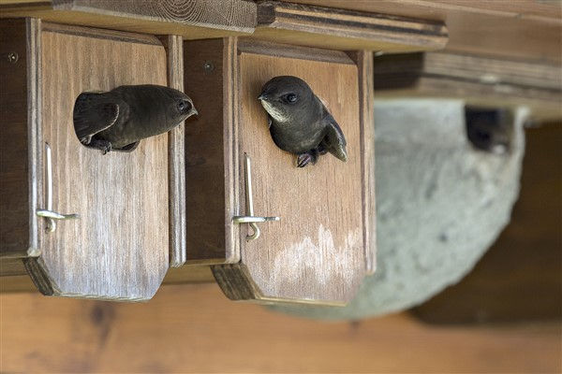
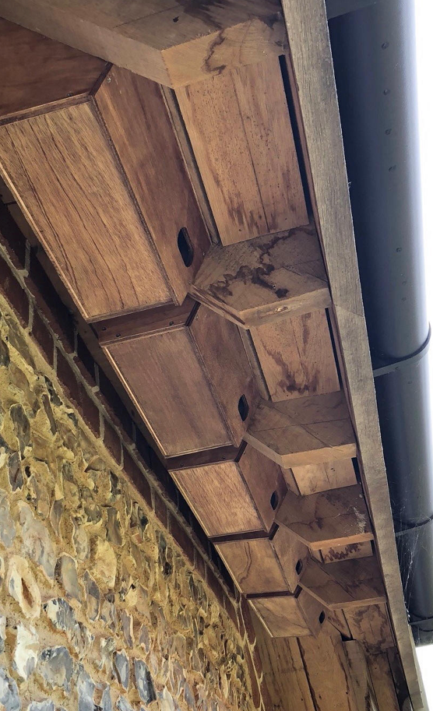
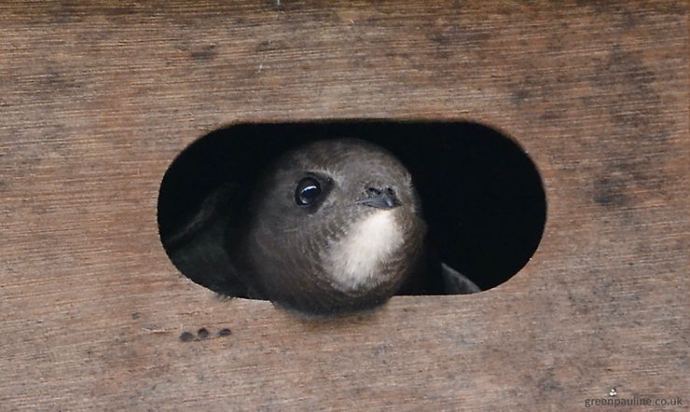
Part 2: When biodiversity was the plan
Winchester Cathedral Swift Project
HAMPSHIRE, the UNITED KINGDOM
THE IMPACT:
2020: 0 pairs (baseline)
2024: 16 pairs bred (80% occupancy)
Cathedral project is flagship of broader Winchester campaign with 500+ boxes city-wide (31% population increase 2018-2024)
Cathedral success became replication model for churches across Hampshire
Hampshire Swifts runs public swift walks, talks, and volunteer monitoring network
Charity monitors planning applications and advocates for swift bricks in new developments

Slide 19
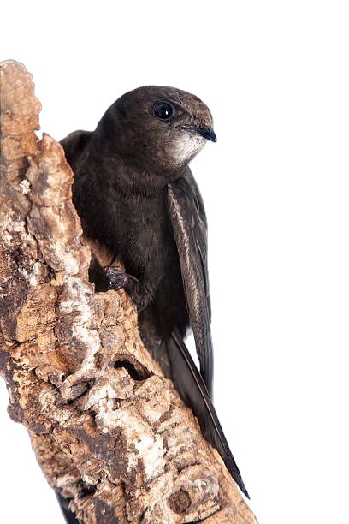
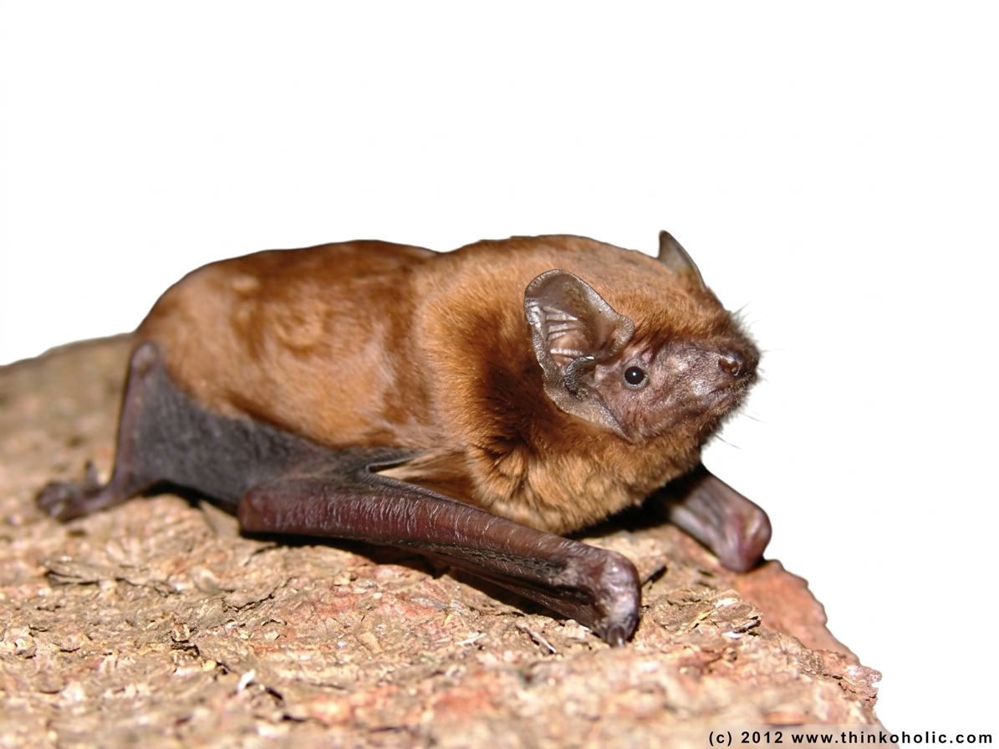
THANK YOU!

